Slide 1
Predicting Hotel Cancellations
Theodore Koby-Hercsky
Video Link: https://youtu.be/iKnCc_wPw9k

Slide 2
AGENDA
Introduction
Business Problem & Primary goals
Background on Data
Data Exploration
Summary

Slide 3
INTRODUCTION
Does the duration of a stay have an impact on cancellation rates?
Duration of stay has a direct impact on cancellations as a “room booked for only 1 or 2 nights; is more likely to be cancelled then if the length of stay is 3 nights or longer.” (Eric)

Slide 4
PRIMARY GOALS
Business Problem
Hotels are seeing an increase in cancellations due to options such as the 24-hour cancellation windows.
Provide hotels with a hassle-free way to predict cancellations to allow accurate forecasts for future occupancy rates.

Slide 5
Background on Data
Data consist of two hotels
City hotel – Lisbon Portugal
Resort hotel – Algarve Portugal
Date range from July 2015 – August 2017
31 variables
Daily Rate
Cancellations
Lead time
Guest Type

Slide 6
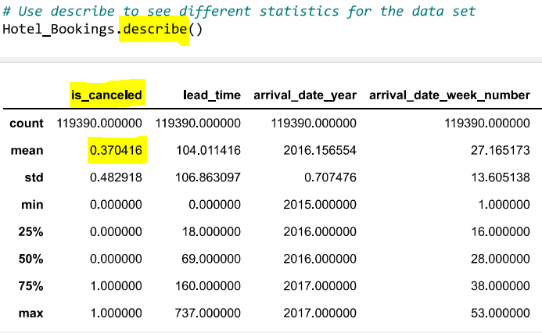
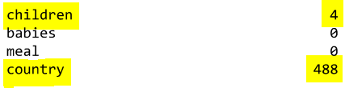

Data Exploration
Describe Method
Describe – “method that returns description of the data in the DataFrame.” (W3Schools)
Mean Cancelation Rate of 37.04%
Insnull() Function
Isnull() – “detect missing values for an array-like object.” (Pandas)
Children missing 4
Country missing 488
Agent missing 16,340
Company missing 112,593

Slide 7
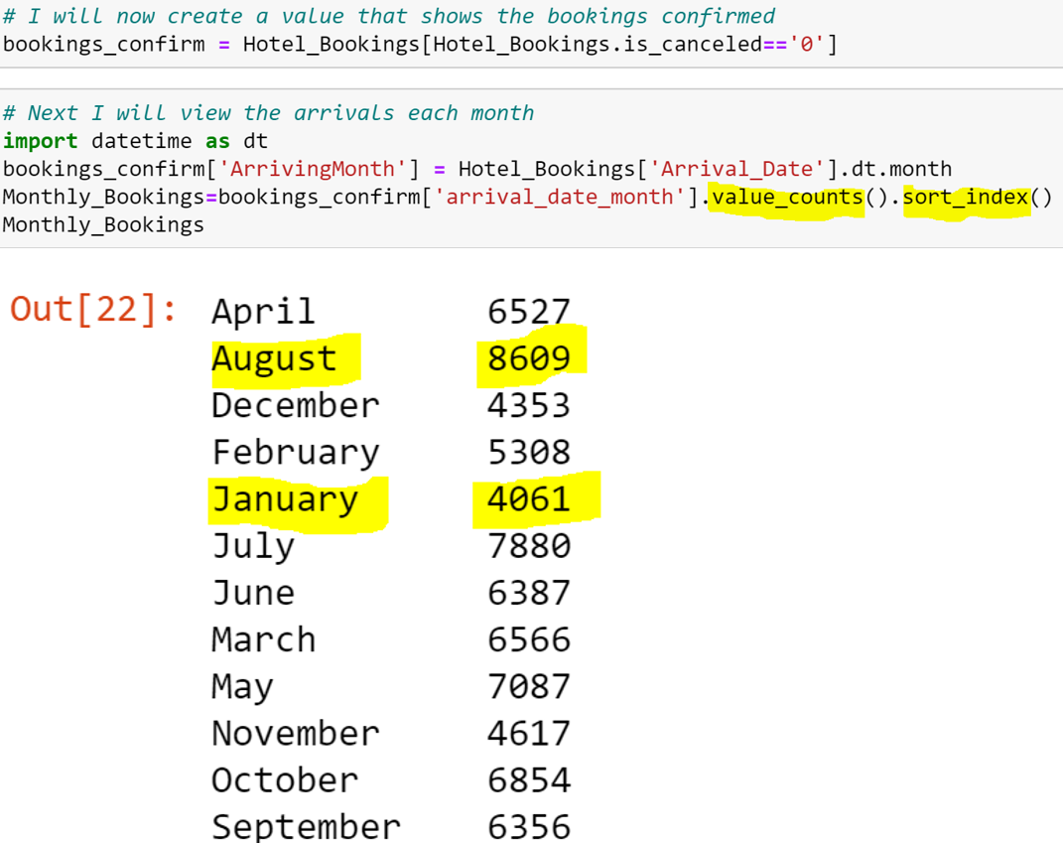
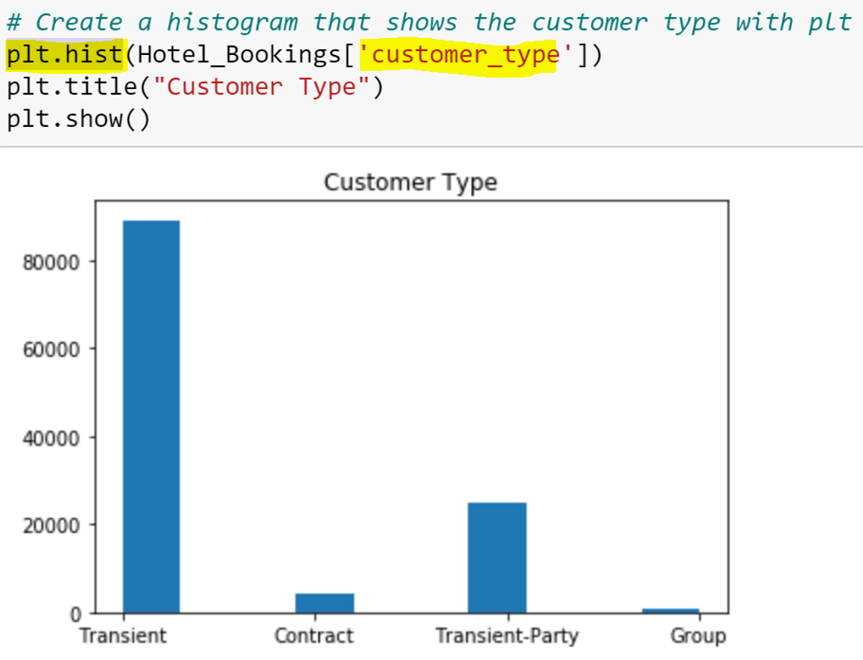
Data Exploration
Sort_index() on Arrival Month
Sort_index() – “returns a new DataFrame sorted by label.” (Pandas.dataframe)
Highest Arrivals August – 8,609
Lowest Arrivals January – 4,061
Histogram Visualization
hist() – “plot pre-computed bins and treating each bin as a single point with a weight equal to its count.” (Hunter)
Highest number of guests – Transient Guests
Lowest number of guests - Groups

Slide 8
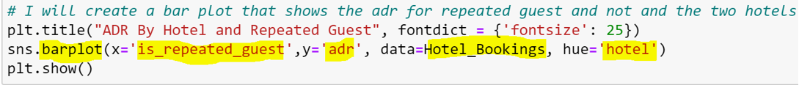
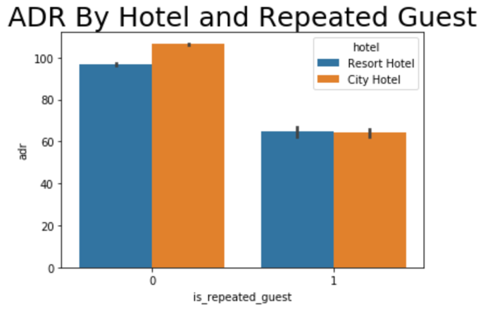
Data Exploration
first time guest and repeat guest average daily rate
First Time Guest
City Hotel Average Daily Rate - $100 and above
Resort Hotel Average Daily Rate – above $90
Repeat Guest
City Hotel Average Daily Rate - $60
Resort Hotel Average Daily Rate – above $60

Slide 9
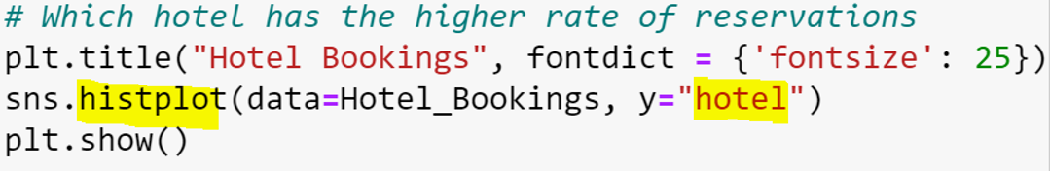
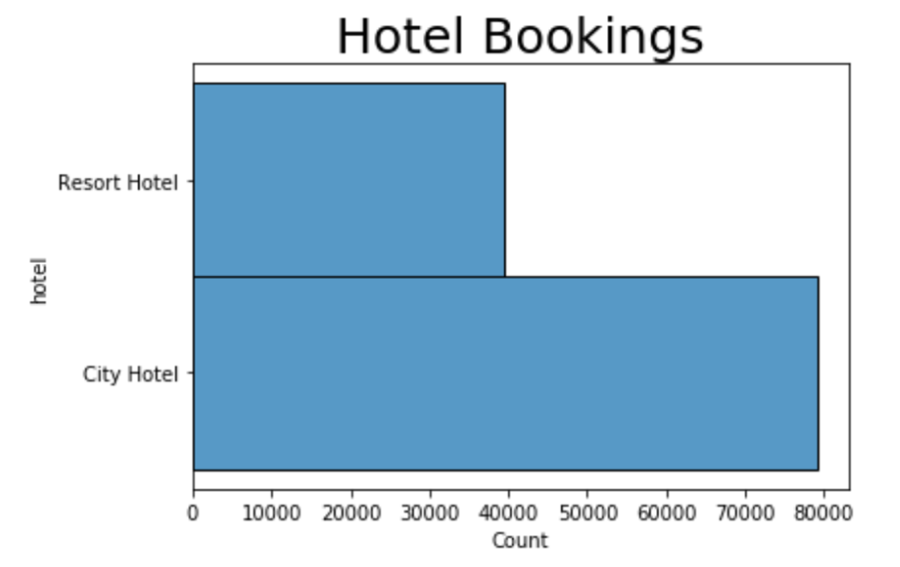
Data Exploration
Booking Rate Per hotel
Resort Hotel
Around 40,000 bookings
City Hotel
Under 80,000 bookings

Slide 10
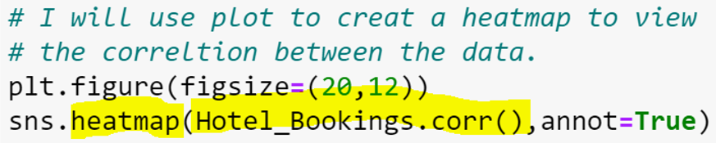
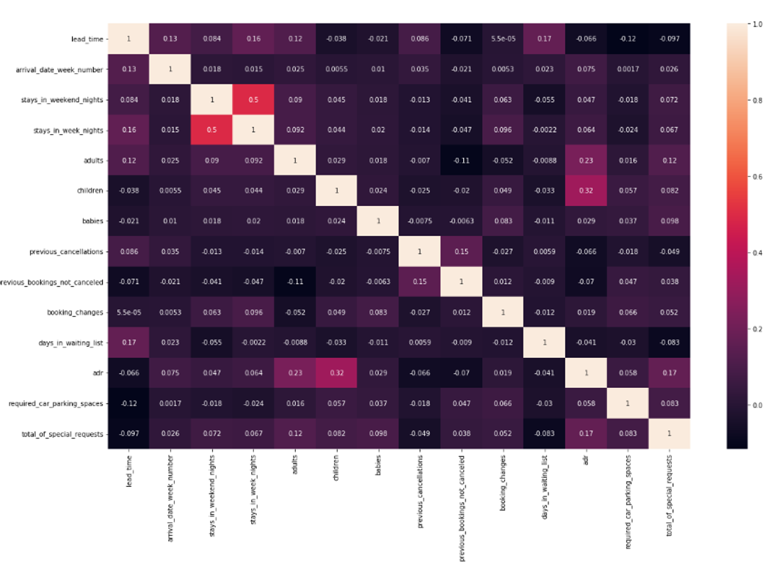
Data Exploration
Hotel data Heat Map
Seaborn Heatmap
“Axes-level function and will draw the heatmap and used to plot a colormap.” (Waskom)
Highest Correlation
ADR and Children 33% Correlation

Slide 11
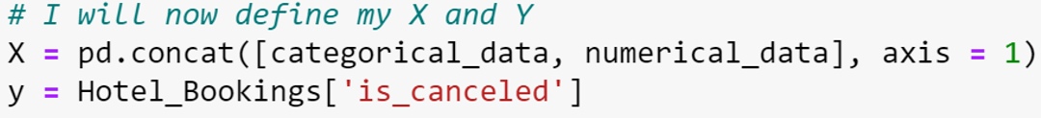
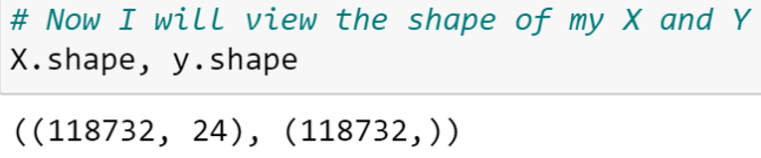
Modeling Setting the X and y
X Value
Set to all remaining values
Shape: 118,732 values for 24 variables
Y Value
Set to “is_canceled” Variable
Shape: 118,732 values

Slide 12
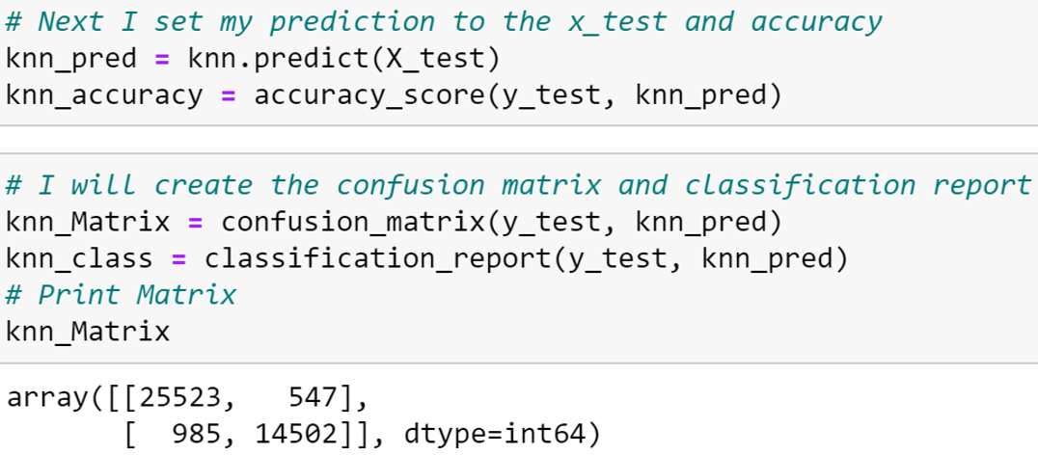
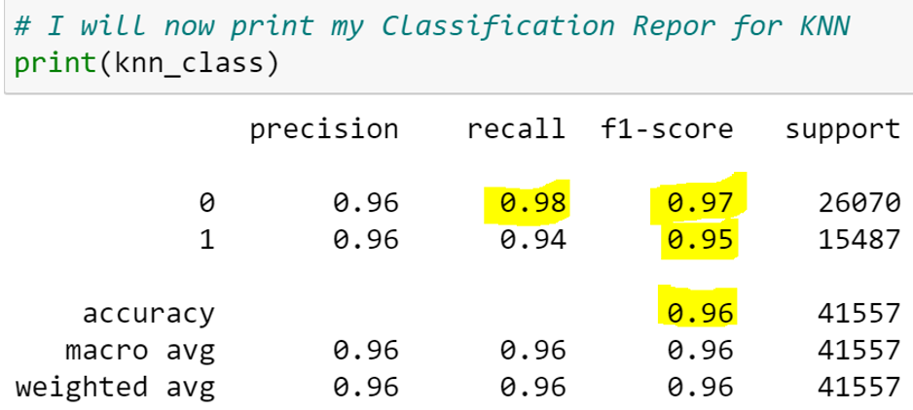
Modeling K-Nearest Neighbors
K-Nearest Neighbors
“one of the most famous machine learning algorithms that is unsupervised and Nonlinear.” (Real Python)
Recall
98%
F1-Score
97%

Slide 13
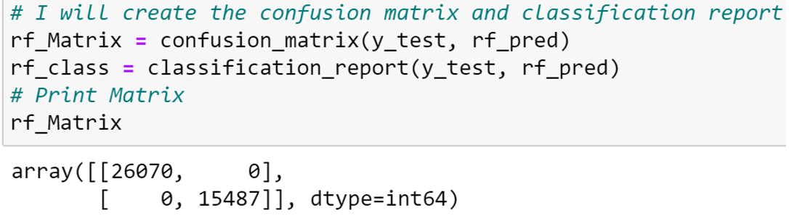
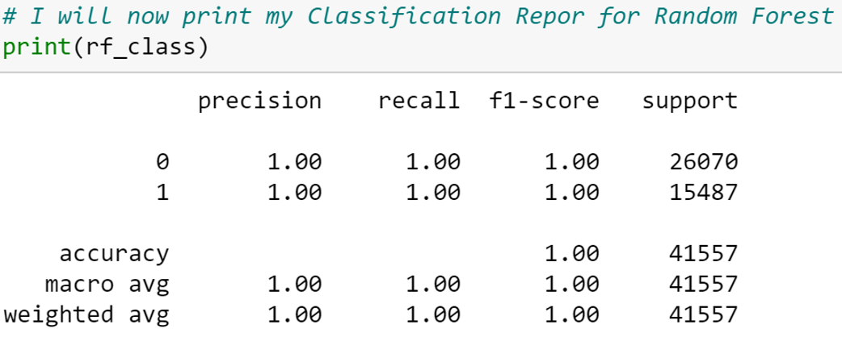
Modeling Random Forest Classifier
Random Forest Classifier
“supervised learning algorithm that can be used both for classification and regression and is flexible and easy to use.” (Navlani)
Array of 26,070 and 15,487

Slide 14
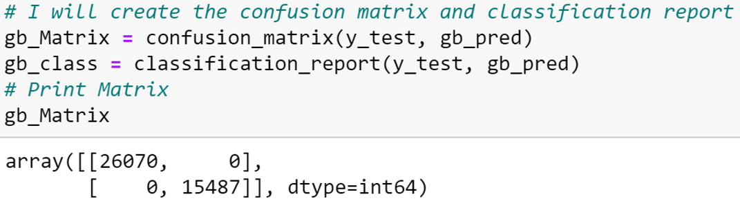
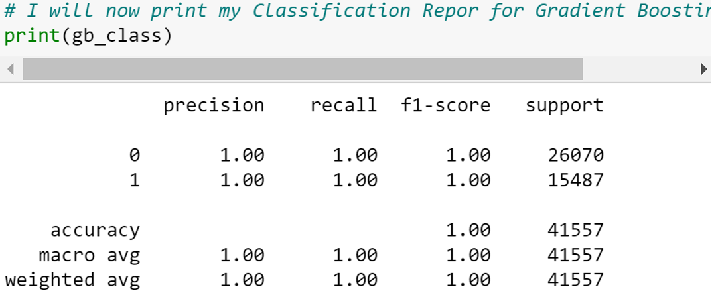
Modeling Gradient Boosting Classifier
Gradient Boosting Classifier
“group of machine learning algorithms that combine many weak learning models together to create a strong predictive model.” (Nelson)
Recall
100%
F1-Score
100%

Slide 15
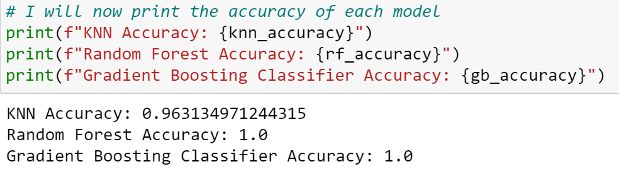
Overview of models
K-Nearest Neighbors
Cancellation Precision: 96%
Cancellation Recall: 94%
Cancellation F1-Score: 95%
Gradient Boosting Classifier
Cancellation Precision: 100%
Cancellation Recall: 100%
Cancellation F1-Score: 100%
Random Forest Classifier
Cancellation Precision: 100%
Cancellation Recall: 100%
Cancellation F1-Score: 100%

Slide 16
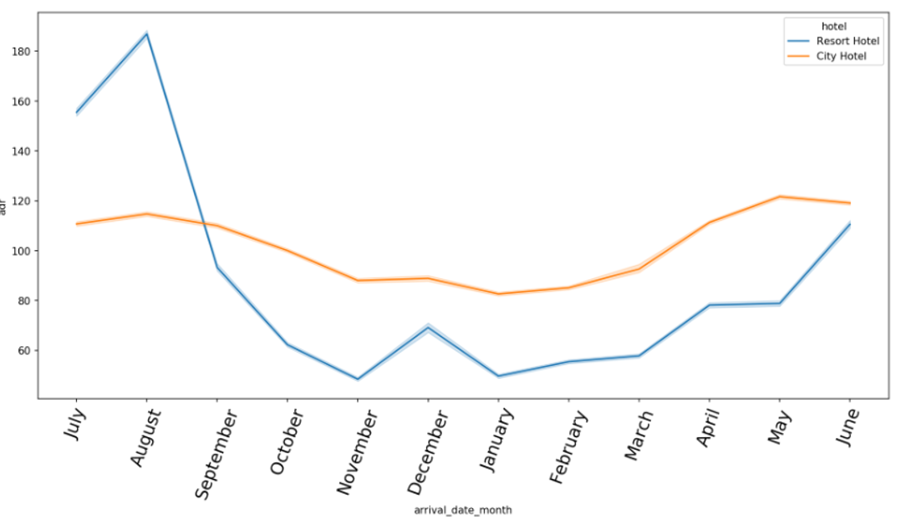
Conclusion
Overall, all models are great choices when predicting cancellation rates for hotels.
Best Choice with 100% Accuracy
Random Forest Classifier
Gradient Boosting Classifier
Another great option with 96% Accuracy
K-Nearest Neighbors
Resort Hotel – Spikes during summer and a steady low price for the rest of the year
City Hotel– Steady price throughout the year that ranges from $100 to $120.

Slide 17

Citations
Eric. (n.d.). Hotel cancellations pose a great challenge. Revenue Management Software für Hotels jeder Größe. Retrieved December 6, 2022, from https://www.rateboard.io/en/blog/hotel-cancellations-pose-a-great-challenge
W3Schools. (n.d.). Pandas DataFrame describe() Method. Pandas dataframe describe() method. Retrieved December 6, 2022, from https://www.w3schools.com/python/pandas/ref_df_describe.asp
Pandas isnull() function. w3resource. (n.d.). Retrieved December 6, 2022, from https://www.w3resource.com/pandas/isnull.php#:~:text=The%20isnull()%20function%20is,arrays%2C%20NaT%20in%20datetimelike).&text=Object%20to%20check%20for%20null%20or%20missing%20values
Waskom, M. (n.d.). Seaborn.heatmap#. seaborn.heatmap - seaborn 0.12.1 documentation. Retrieved December 7, 2022, from https://seaborn.pydata.org/generated/seaborn.heatmap.html

